Slide 1

Coursera Capstone IBM Data Science Professional Certificate
Clustering Areas of Bangalore on the basis of number of Night Life Venues in the Area
By: Manash Pratim Borah

Slide 2
Introduction
Bangalore, not only known as the ‘Silicon Valley of India’ but it is also the ‘Pub Capital of India’.
Bangalore has been flooded with people from all across India and abroad.
The night life of Bangalore grew, with the establishment of numerous clubs, pubs and restaurants.

Slide 3
Introduction
For someone who wants to start a restaurant or other night life venues, choice of location is very critical as in can make or break them.

Slide 4
Business Problem
The objective here is to use the KMeans algorithm to cluster the different areas based on the number of night life venues present in them.
The algorithm will help to differentiate areas with High, Medium and Low density of such venues.
It can help get the lion’s share of profit instead of stepping into a place where it is already crowded with old established brands

Slide 5
Target Audience
Property Developers
Investors
Person for whom living condition takes into factor proximity to night life venues

Slide 6
Data
List of Areas:
https://pincode.net.in/
https://www.indiatvnews.com/pincode/karnataka/bangalore/bangalore-city
List of Coordinates:
Geopy API
List of Venues:
Foursquare API

Slide 7
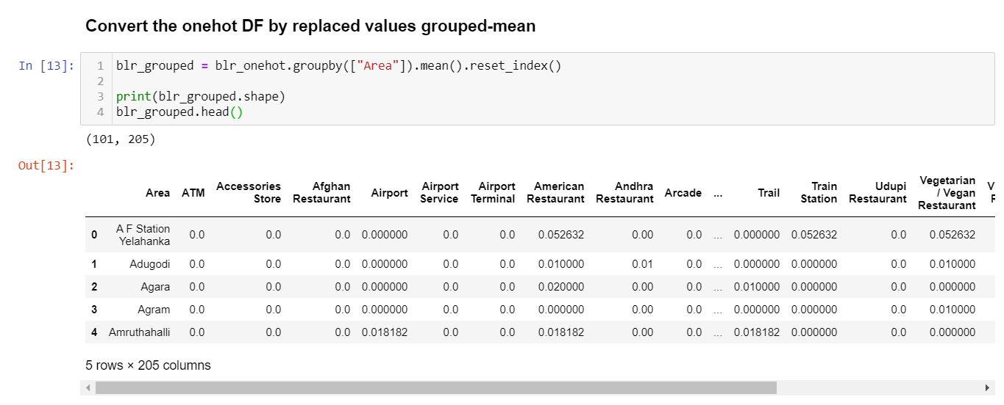
Methodology
One-Hot Encoding: Convert Categorical into Numerical data

Slide 8
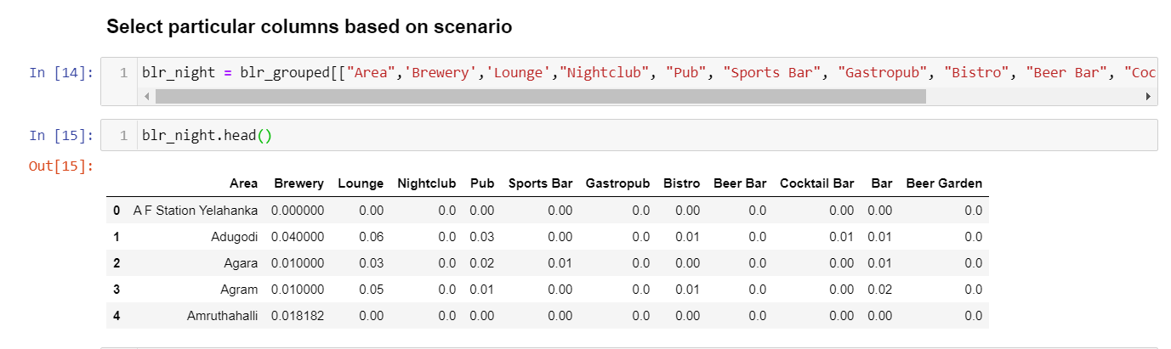
Methodology
Grouping one-hot encoding based on Areas

Slide 9
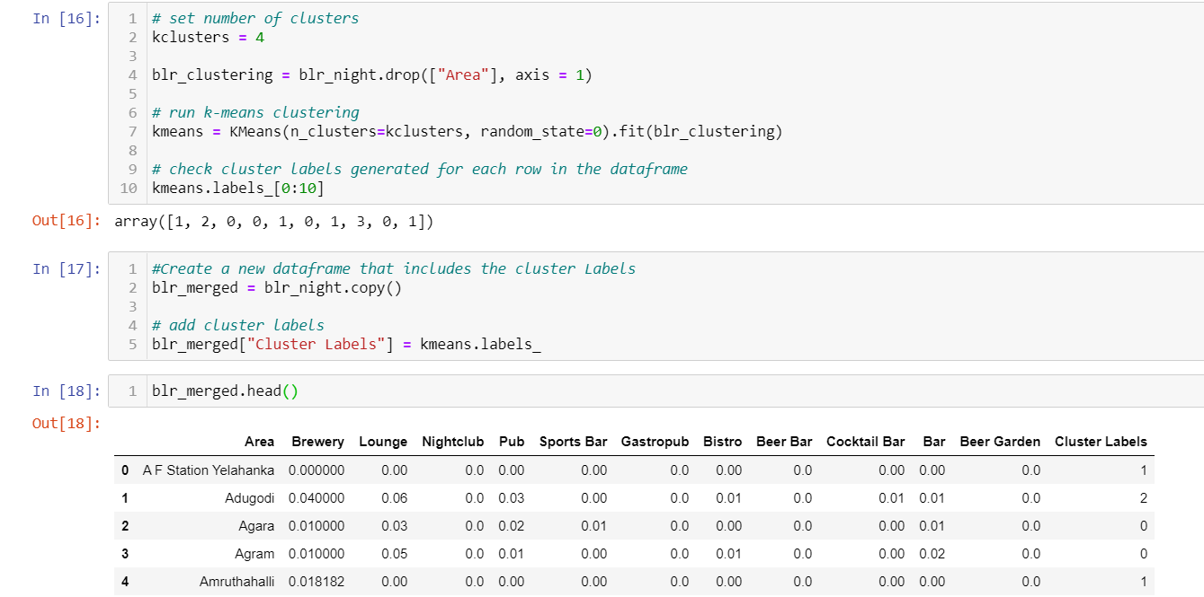
Methodology
KMeans: To create clusters and add cluster labels to the data frame.

Slide 10
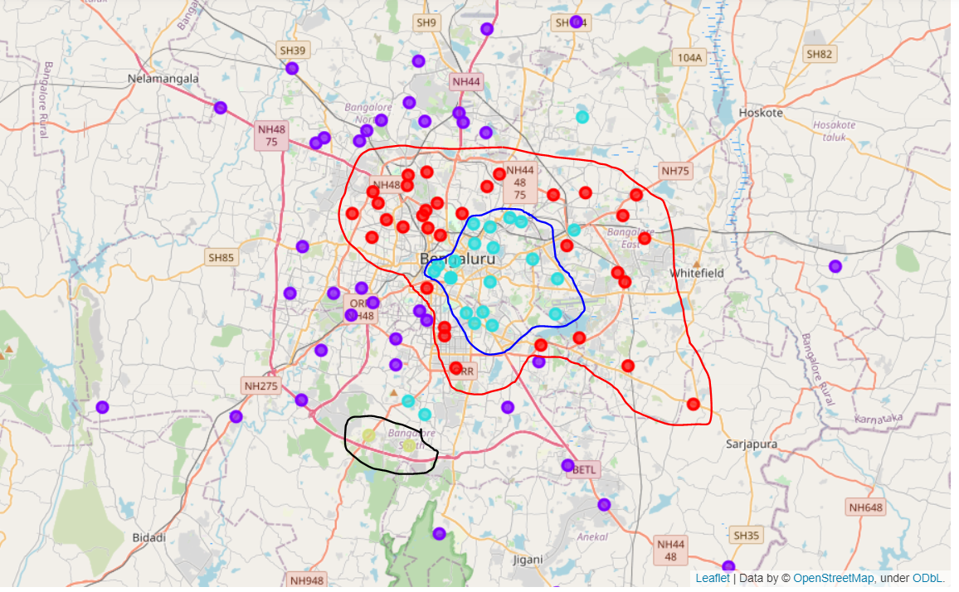
Result

Slide 11
Result
The inner cluster of cyan dots represent – Cluster 2
The mid-outer cluster of red dots represent – Cluster 0
The outer cluster of violet dots represent – Cluster 1
The small cluster of olive dots towards lower left of map represent – Cluster 3

Slide 12
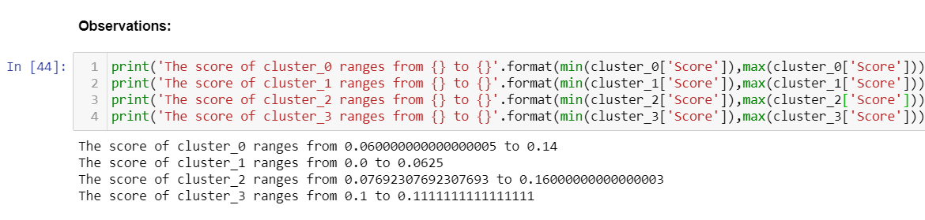
Result
Create a score column for each cluster where we add up all one-hot encoded values of each venue
Cluster_2 > Cluster_0 > Cluster_1 > Cluster_3

Slide 13
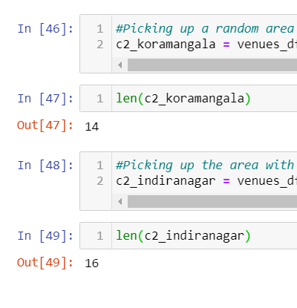
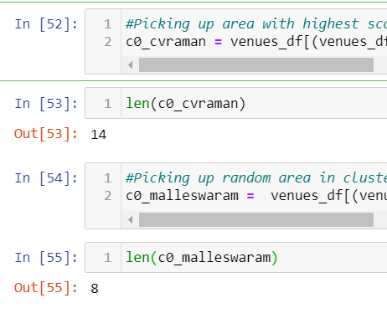
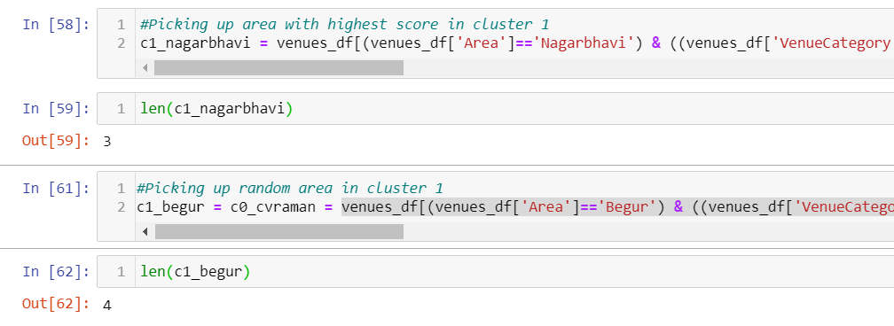
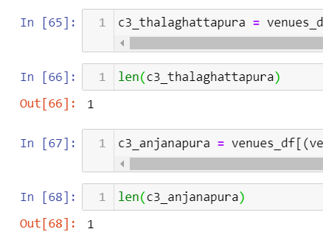
Result
As we can see here from the length of different clusters we see cluster 2 having maximum venues followed by cluster 0 then cluster 1 and finally cluster 0.

Slide 14
Result
Cluster | Area | Number of Venues
0 | CV Raman Nagar | 14
 | Malleswaram | 8
1 | Nagarbhavi | 3
 | Begur | 4
2 | Koramangala | 14
 | Indiranagar | 16
3 | Thalaghattapura | 1
 | Anjanapura | 1

Slide 15
Discussion
There is high competition in Cluster_2 and is probably a saturated market with brands with a strong hold on customer loyalty.
Cluster_0 has potential as it is not as saturated as cluster_2 but not as far from the city heart as cluster_1.
Cluster_1 is a tricky call to make as with the ever growing population of a city like Bangalore many people are moving away from the city to more peaceful areas, so it wouldn’t be a bad choice to set up a major hub where people can come out of the city as a weekend trip.
Cluster_3 is not a very good call as far as I can tell but if there is a influx of people there than it would be a great place to set up a new business as it is almost untouched.

Slide 16
Conclusion

